Slide 1
Whole Class Reading – LKS2
The Stone Age Clash by Josh Lacey
www.manicstreetteachers.com

Slide 2
LQ: Can I read fluently from the book ‘The Stone Age Clash’?
CLICK THE LINK HERE TO ACCESS THE TEXT

Slide 3
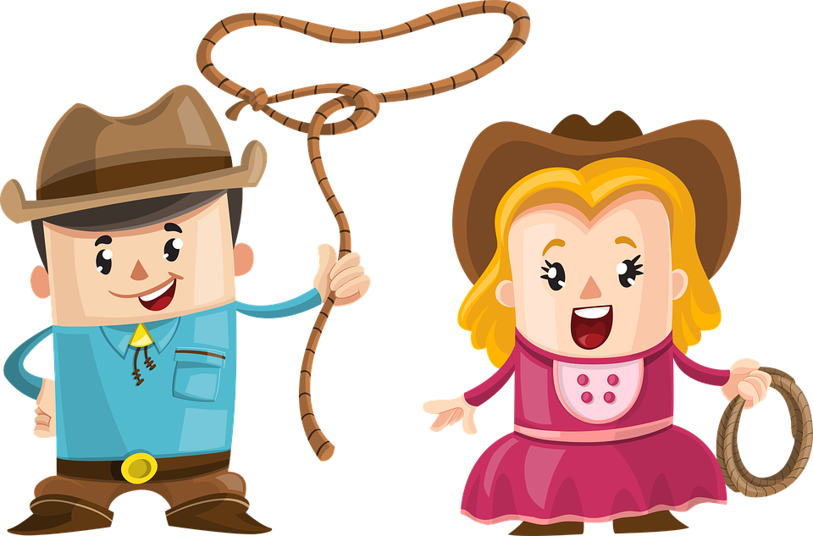
Core Reading Skills
Vocabulary
Retrieval
Fluency
Inference

Slide 4
Lesson Features
General Gist
Oracy
Challenge
D.I.S.C.O.

Slide 5
Agenda
Introduce the author and the book
Pre-vocabulary
Read and discuss the text
Read fluently and self-assess

Slide 6
Introduce the author and the book
Josh Lacey is the author of ‘The Island of Thieves’ and ‘Bearkeeper’ amongst many others. He used to be a journalist. He also writes under the pseudonym Joshua Doder.
Twins, Scarlett and Thomas are learning about the Stone Age, so Grandad lets them use his time machine. Thomas wants to see a sabre-toothed tiger and Scarlett wants to see Stonehenge. They were thousands of years apart so it requires two trips!

Slide 7
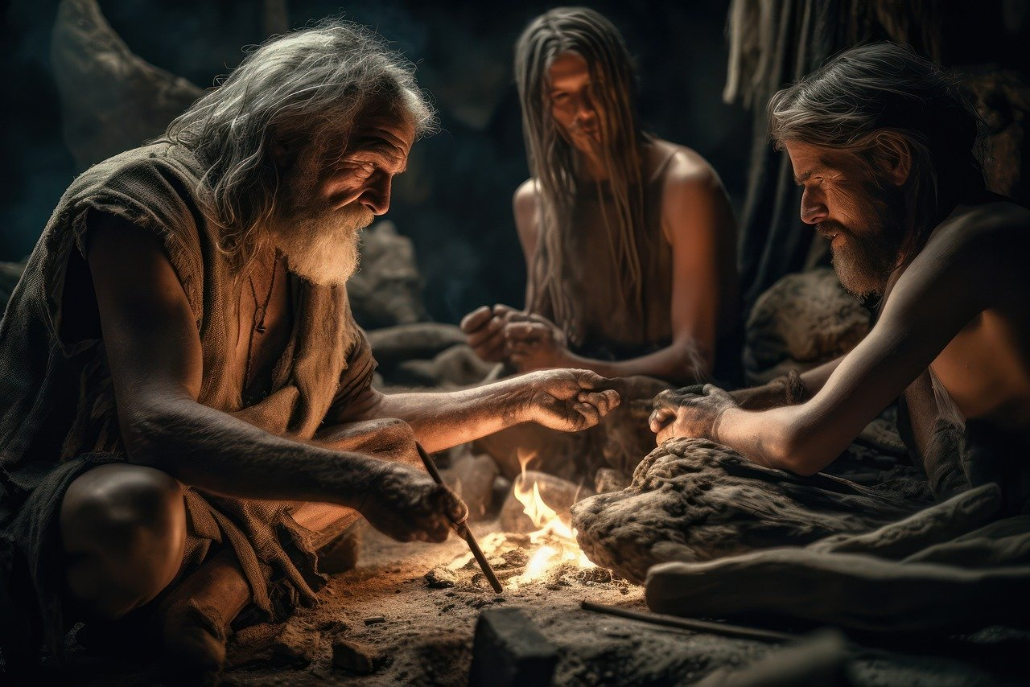
Introduce the author and the book
The Stone Age was so called due to the discovery of stone tools, which have been dated to some 3.3 million years ago. It is usually divided into three periods: Palaeolithic Period, Mesolithic Period and the Neolithic Period.

Slide 8
Pre-vocabulary
rickety (r-i-ck-e-t-y) - poorly made and likely to collapse
contraption (c-o-n-t-r-a-p-tion) - a machine or device that appears strange or complicated
wormhole (w-or-m-h-ole) - a connection between separated regions of space-time
workbench (w-or-k-b-e-n-ch) - a flat table for carpentry
devices (d-e-v-i-c-e-s) – a thing made for a particular purpose

Slide 9
Read the poem fluently
Task 1: Vocabulary Pronunciation
Identify all the pre-vocabulary words and highlight them in the text.
Check with your partner that you can pronounce them all accurately.

Slide 10
Read and discuss the text
Read pages 1 - 4 by yourself, looking out carefully for the pre-vocabulary.
If there are other words you are not sure of the meaning of, underline them and we can discuss them when everyone has finished reading.
CLICK THE LINK HERE TO ACCESS THE TEXT

Slide 11
The General Gist Answer the 5 questions below from what your remember after reading.
Read and discuss the text
Where is Grandad’s wormhole?
What is Grandad really good at doing?
Where are Mum and Dad going?
When are the twins spending time at their Grandad’s?
What does Grandad have on the front of his barn?

Slide 12
Read the poem fluently
Task 1: Listening and Echo Reading
Listen to me as I read page 1. Can you hear the following?
My Pace (Where do I slow down and speed up?)
Emphasis (What words do I make a point of/why?)
My tone (menacing/dark/joyful/uplifting/determined etc)
Using underlining/circling and notes, mark your text to indicate what we have just done.
My Pace (Where do I slow down and speed up?) ↑↓
Emphasis (What words do I make a point of/why?) ____________
My tone (Menacing/dark/joyful/uplifting/determined etc) joyful
Task 2: Text Marking

Slide 13
Smooth Reading
Read fluently from the text
A reads Page 1 as smoothly as possible with B listening and making notes of words which were not read smoothly (a maximum of 5) then helps them with those words .
B then reads Page 1 as smoothly possible with A listening and making notes of words which were not read smoothly (a maximum of 5) and helps them with these parts.
Re-read again to help smooth out the errors. Can you perform to the class?

Slide 14
D.I.S.C.O. Questions
Develop
Imagine
Switch
Compare
Oppose

Slide 15
D.I.S.C.O. – Imagine
Imagine you have been invited into Grandad’s barn.
Where would you want the wormhole to take you and why?
Send a text to your friend explaining where you are and what happened (120 characters only).

Slide 16
LQ: Can I read fluently from the book ‘The Stone Age Clash’?
1 2 3 4 5
Self Assessment Score: / 5

Slide 17
www.manicstreetteachers.com

